Slide 1
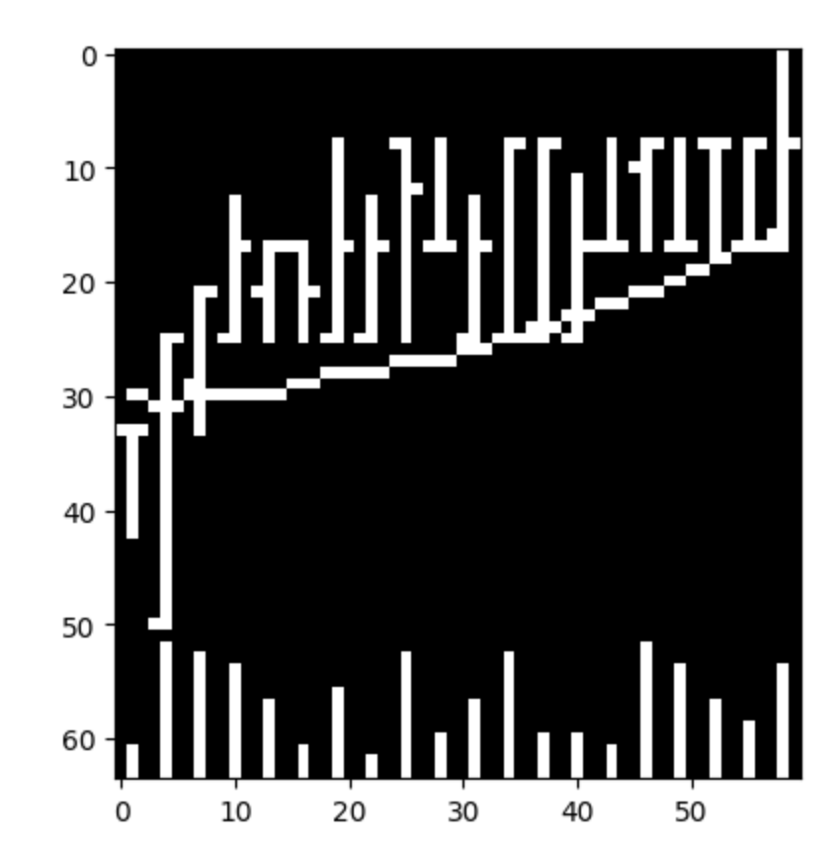
Market Data
Open High Low Close
Each OHLC chart is 5/20/60 business days of data
Each day 3pixels wide
Eg: Total image for 20 days == 60x64 pixels wide
Returns scaled so the largest price is the top of the image
Three types of information in image
Direction stock movements
Volatility data
SMA (5/20/60)

Slide 2
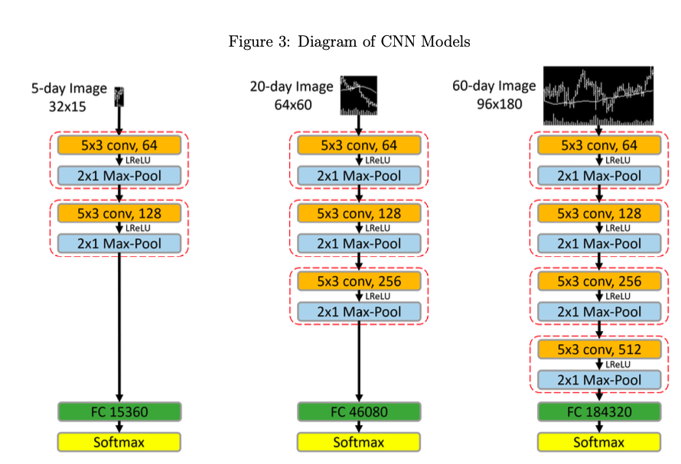
CNN Architecture
Goal for CNN is to balance tradeoff between complex pattern recognition and interpretability
Why CNN?
Alternative to the time series format that can uncover complex patterns
Technical traders have long relied on geometry and SMA’s (cognition) to make trading decisions
CNN designed to solve positionality, scale etc… and may require less parameterization than NNs
Architecture Highlights
Loss Funct:
Adam, .0001
50% dropout to fully connected layer
Stopping after 2 consecutive epochs of higher error
70% train 30% validation from 1993-2000 and testing from 2001-2019
9 separate models (combinations of I5, I20, I60)

Slide 3
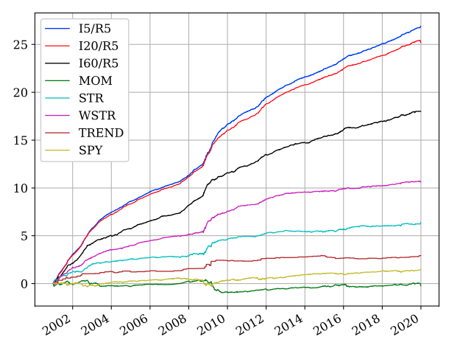
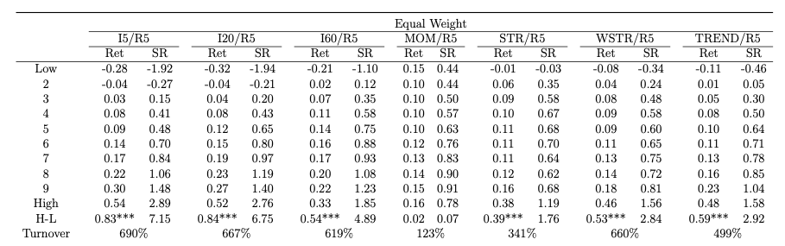
Evaluation
I-Images / R-Prediction
Prediction is most potent (accurate) in the 5 day period after the image is observed
Sharpe ratios exceed 5 in a High Low portfolio sorted by decile (High-Low)(10-1)
Outperforms Momentum and Short Term Reversal with no parameterization needed
Predictions are context independent
Work well in international markets as well as varying time periods
Volatility surprisingly low

Slide 4
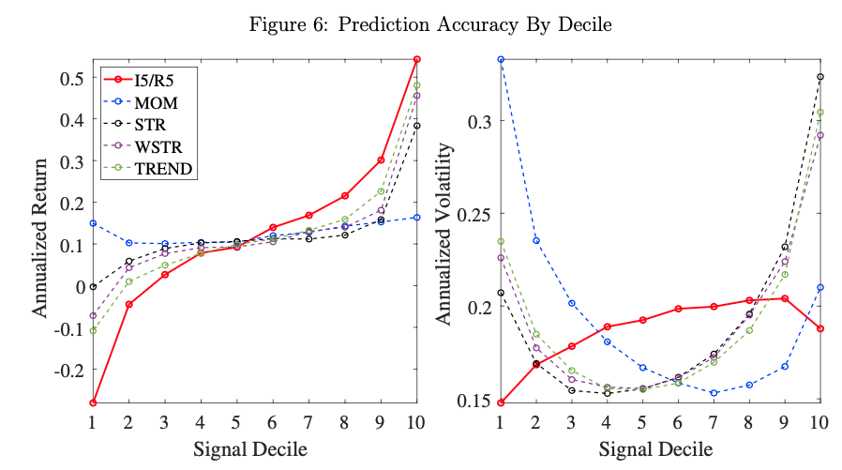
Evaluation (Cont.)
Return becomes less significant when we ask the model to predict monthly or quarterly returns (20,60), but still above the benchmarks (MOM, WSTR) due to lower volatility
When restricted to largest 500 stocks, returns are less potent
Is the CNN just learning to pick volatility?
Highest correlated feature with the CNN is Short Term Reversal (-34%)
CNN performs better than ~96% of all (7,846) technical trading strategies

Slide 5
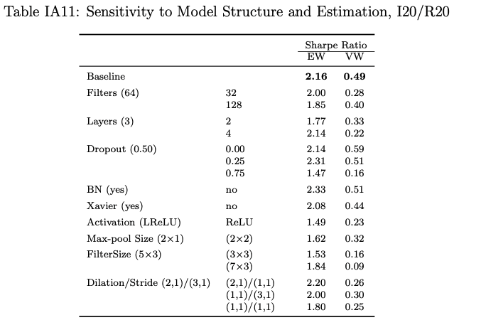
Sensitivity
Data Augmentation
Volume and MA bar seem to contribute to noise for I5, but very useful for I20, I60
Removing smaller stocks (due to volatility/swings) leaves model unchanged
Changing pixel representation (centered, top) results in similar scores (sharpe ratio & return)
Model selection
Changing number of convolution layers, dropout rate, dilation, degrades model performance or leaves results largely unchanged
Computer Vision Models
CNN v. HOG v. HAAR
CNN outperforms for I5
CNN mostly outperforms for I20, I60
HAAR feature selection using Adaboost as too many features (100Million+)

Slide 6
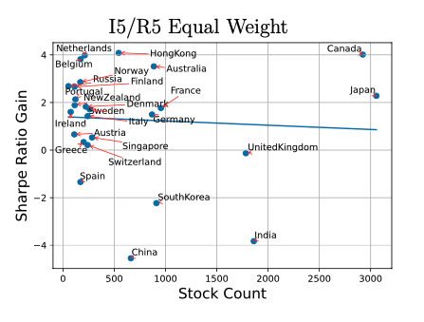
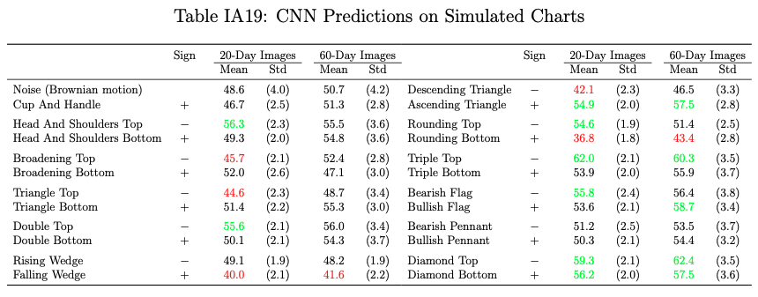
Technical Patterns/Transfer Learning
Technical Patterns
Model extended to predict probability of different technical patterns producing positive 20-day return based on 10K trained images
Transfer Learning
The paper also explores transfer learning with other markets, both on trained and untrained (transfer) models
Transferring the trained model produces high Sharpe in most other markets
When data is insufficient in other markets (stock count) this could be beneficial → Arbitrages

Slide 7
Thoughts
This paper implies credibility to financial technical analysis, and takes the human out of the equation
I am unsure of train/test though process
train and validation on 1993-2000 data. Markets may have fundamentally changed since then?
Why not sample different time periods from data?
Paper made good effort to experiment with sensitivity of model parameters, possibly more can be experimented with…
Sharpe ratios degraded slightly when stocks are limited to 500 largest cap, implying maybe more volatile picks when unrestricted (smaller and more illiquid stocks)..

